Slide 1
DANGOTE
CEMENT PLC
CHALLENGE 4
Transforming Manual Plant Reporting
into a Governed Digital System
Digital KPI
Automation &
Data Quality
15
4
5
100%
Core KPIs Tracked
Plants Connected
User Roles & RLS
Digital Reporting
A Power Platform Solution for
Obajana · Ibese · Gboko · Okpella
Solution Stack
Power Apps
Power Automate
SharePoint
Dataverse
Power BI + RLS
Dangote Industries Innovation Challenge | 2025
Notes:
Open by acknowledging DCP's ambition for operational excellence. Frame this as infrastructure for performance improvement, not just a reporting tool. The four plants represent Nigeria's largest cement capacity.

Slide 2
SLIDE 02
Current-State Problem Diagnosis
DCP's plant performance reporting across four sites depends entirely on manual processes — creating systemic risks that scale with the business.
Reporting Delays
Inconsistent Templates
Missing Numbers
Data submitted after decision windows close, forcing management to act on yesterday's numbers.
Each plant uses its own format — cross-plant comparison is manual, error-prone, and time-consuming.
No enforcement on required fields. KPI gaps appear in reports after the fact with no audit trail.
No Validation Layer
Weak Traceability
Poor Exception Visibility
Implausible values (zero clinker output, negative downtime) pass through unchecked into dashboards.
Who submitted? Who approved? When? These questions cannot be answered reliably under the current system.
Management learns of production issues through verbal escalation — not through live exception alerts.
These are not isolated incidents — they are structural failures of a manual system operating at 35+ Mta scale across four geographically distributed plants.
Notes:
Anchor each pain point to operational reality. Manual reporting at Dangote's scale — 17.7Mt Nigeria volumes in 2025 — creates compounding risk. Each point maps directly to a challenge deliverable.

Slide 3
SLIDE 03
Data Insights & Key Assumptions
15 Core KPIs Across 4 Categories
DCP 2025 Financial Anchors
5 KPIs
Production & Throughput
₦681.9B
₦165.9B
Clinker Vol · Cement Vol · Kiln Util · OEE · Clinker Factor
Fuel & Power Cost
(2025)
Plant Maintenance
Cost (2025)
3 KPIs
Energy & Utilities
Specific Heat · Specific Power · Thermal Substitution Rate
59.6%
17.7Mt
3 KPIs
Quality & Compliance
Free Lime · Blaine Fineness · Off-spec Batch Rate
Nigeria EBITDA
Margin (2025)
Nigeria Cement
Volume (2025)
3 KPIs
Maintenance
PM Compliance · MTBF · Maintenance Cost per Tonne
Key Assumptions
DCP operates Microsoft 365 — Power Platform is available
Plant operators have basic digital literacy for form entry
KPI benchmarks reference cement industry standards
Pilot begins at Obajana (highest complexity, 5 lines)
Dataverse premium licensing approved for reporting tier
1 KPI
Governance
Submission Timeliness — tracks reporting discipline
Notes:
The financial figures come directly from Dangote Cement's 2025 full-year results presentation. These numbers anchor our business case — our KPIs directly drive the cost lines that determine EBITDA margin.

Slide 4
SLIDE 04
Root-Cause Hypothesis
Root Cause: DCP lacks a single, enforced data entry standard and automated validation layer across its four Nigerian plants — causing downstream reporting failures at every management level.
01
No Standardised
Entry Point
02
No Automated
Validation
03
No Governance
or Accountability
Each plant uses different Excel templates
No mandatory field enforcement
Formatting varies — consolidation is manual
No plant-level timestamp or submitter ID captured
Data goes directly to reports without checks
Out-of-range values pass through undetected
Missing fields only discovered during review
No exception classification or severity tiering
No formal sign-off or approval workflow
Escalation is verbal — not documented
No audit trail of submissions or changes
Timeliness is tracked manually (or not at all)
No Standard Entry
→
No Validation
→
No Accountability
→
Unreliable KPI Data
→
Poor Management Decisions
Notes:
This slide sets up the 'why' behind our solution. Three root causes map directly to three solution components: Power Apps (standardised entry), Power Automate (validation + governance), Power BI (visibility).

Slide 5
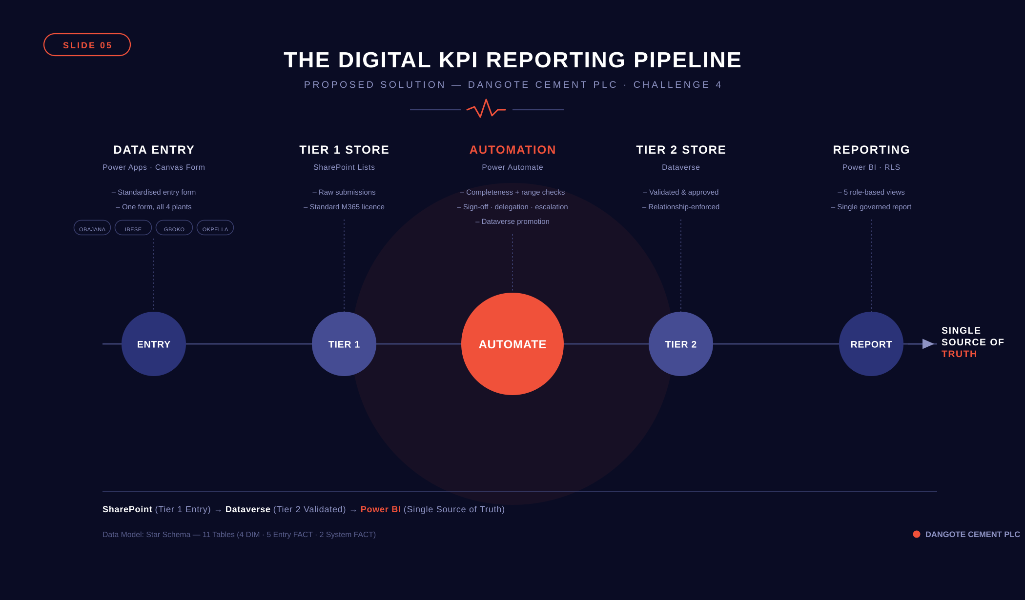
Notes:
This is the hero slide. Walk through the architecture left to right — data enters via Power Apps, lands in SharePoint, Power Automate validates and routes for approval, clean data moves to Dataverse, Power BI serves role-filtered dashboards. Every component addresses a root cause from Slide 4.

Slide 6
SLIDE 06
Technical Feasibility & Operating Concept
Daily Operating Cycle
Why Power Platform is Feasible for DCP
1
Operator Submits
✓
Microsoft 365 already deployed at DCP
Plant operator opens Power Apps form on any device. Enters raw inputs for production, energy, quality, and maintenance. System captures Plant ID, timestamp, and user ID automatically.
No new licensing required for entry tier
✓
Power Apps runs on any browser or mobile
2
No hardware investment at plant level
Auto-Validation
Power Automate runs completeness and range checks instantly. Flags exceptions with severity levels (Warning, Critical, Blocker). Quality breaches generate Non-Conformance Records routed to the Data Quality Officer.
✓
SharePoint included in M365 subscription
Tier 1 storage at zero incremental cost
3
Manager Sign-Off
✓
Power Automate handles approval routing
Plant Manager receives Teams + Email approval request. Must approve within 24 hours. Reminder at T+12h, escalation to Regional Manager at T+24h, Executive at T+48h.
No custom code — configurable by IT admin
✓
Power BI Desktop is free to build
4
Publish to Power BI Service for sharing
Dataverse Promotion
Approved submissions are automatically pushed from SharePoint (Tier 1) to Dataverse (Tier 2). Power BI refreshes. All four plant dashboards update simultaneously.
!
Dataverse requires Power Apps Premium
Needed for Tier 2 validated storage — licenced per user at reporting tier only
No Python · No custom database · No third-party software · Fully maintainable by DCP IT
Notes:
Stress that this is deployable within DCP's existing Microsoft ecosystem. The only incremental cost is Dataverse premium licences, and those are limited to the reporting/admin tier only — not every plant operator.

Slide 7
SLIDE 07
Business Case & Expected Impact
↓ ₦6–10B
↓ ₦3–5B
< 2 Hours
> 95%
Est. Annual Fuel & Energy
Savings from better SHC tracking
Est. Maintenance Cost
Reduction from PM compliance
KPI Reporting Cycle
vs. current 24–48 hour manual process
Target Data
Completeness & Timeliness
Cost vs. Benefit Summary
KPI System → EBITDA Bridge
Cost Item | Estimate | Notes
Power Apps Premium (Dataverse) | ₦2–4M/yr | Reporting tier users only (~20 licences)
Power BI Pro | ₦1–2M/yr | Managers + executives (~15 licences)
Implementation & Training | ₦5–8M one-off | IT setup, training, pilot deployment
Ongoing IT Administration | ₦1–2M/yr | Part-time IT admin, no dedicated hire needed
Total Year 1 Cost | ~₦9–16M | All-in including one-off costs
Conservative Annual Benefit | >₦9B | Energy + maintenance savings alone
Specific Heat Consumption KPI
Direct driver of ₦681.9B fuel & power cost line
Clinker Factor KPI
Controls ₦385.5B materials consumed cost
PM Compliance + MTBF KPIs
Reduces unplanned downtime in ₦165.9B maintenance cost
OEE + Kiln Utilization KPIs
Drives volume output efficiency across 35 Mta capacity
Thermal Substitution Rate KPI
Supports Dangote's 10% TSR target — direct fuel cost hedge
Submission Timeliness KPI
Nigeria EBITDA improved from 49.6% → 59.6% in 2025. This system provides the data infrastructure to sustain and extend that improvement.
Reduces management decision lag — protects margin response time
Notes:
Lead with the EBITDA bridge — judges want to see commercial understanding. The ROI is overwhelming: ~₦9B+ in conservative savings against ₦16M implementation cost. Keep cost estimates conservative and note they are indicative.

Slide 8
SLIDE 08
Risk, Safety, Sustainability & Mitigation
Risk Register
Category | Risk | Severity | Mitigation
Change Mgmt | Operator resistance to digital submission | High | Phased rollout starting with Obajana. Champions programme — train 2 super-users per plant before go-live.
Technical | SharePoint 5,000-item list threshold | Medium | Implement indexed columns and filtered views. Archive completed submissions quarterly to maintain performance.
Security | RLS misconfiguration — wrong data visible to users | High | Dedicated Power BI RLS testing protocol before go-live. Role assignments managed centrally by IT admin only.
Licensing | Dataverse premium cost exceeds budget approval | Medium | Limit Dataverse licences to reporting/admin tier. SharePoint entry tier requires no premium licence.
Continuity | Internet/network outage prevents form submission | Medium | Power Apps offline mode enabled. Data syncs when connectivity restores. Paper backup form for critical outages.
Data Quality | Operators enter plausible-but-incorrect values | Low | Cross-validation rules comparing related KPIs (e.g. clinker consumed vs. cement produced ratio checks).
Notes:
Don't skip the sustainability angle — Dangote's TSR programme is a stated executive priority from the 2025 results. Linking our KPI system to their alternative fuel targets shows strategic awareness beyond just IT.

Slide 9
SLIDE 09
Implementation Roadmap & Resources Required
PHASE 1
0 – 30 Days
PHASE 2
1 – 3 Months
PHASE 3
3 – 6 Months
Immediate
Short-Term
Medium-Term
Configure SharePoint lists at Obajana (pilot plant)
Build Power Apps KPI entry form — all 5 input categories
Set up Power Automate validation flow (completeness + range rules)
Create DIM tables in Dataverse (Plant, KilnLine, User, Role)
Train 2 super-users at Obajana as change champions
Establish KPI submission deadline schedule
Go-live at all 4 plants after Obajana pilot review
Deploy Power Automate approval + escalation flows
Publish Power BI dashboards with RLS — all 5 role views
Connect SharePoint → Dataverse promotion workflow
Train all plant managers and data quality officers
Establish exception resolution SLA (48-hour target)
Integrate with ERP / SAP for financial KPI reconciliation
Add predictive exception rules based on historical patterns
SCADA integration for auto-population of production meter readings
Expand KPI set to full 25 (including supporting KPIs)
Executive Power BI app for mobile reporting
Annual KPI taxonomy review and validation rule update cycle
Resources Required:
1× IT admin (Power Platform) · 2× Super-users per plant · Microsoft 365 tenant · Dataverse premium (~20 licences) · Power BI Pro (~15 licences)
Notes:
Anchor Phase 1 as a 30-day sprint to prove value at Obajana before committing to full rollout. This de-risks the investment and gives DCP a real proof-of-concept they can evaluate before Phase 2.

Slide 10
SLIDE 10
Five Reasons to Approve This Proposal
Final
Recommendation
01
Built on Infrastructure DCP Already Has
Power Platform runs on Microsoft 365 — no new vendor, no new procurement cycle, no unfamiliar technology to manage.
02
ROI is Asymmetric
& Pilot Proposal
~₦16M Year 1 total cost against >₦9B in conservative operational savings. The business case does not require optimistic assumptions.
Our Recommendation
03
Directly Addresses the Brief
Deploy the DCP Digital KPI Reporting System using Microsoft Power Platform across all four Nigerian plants — beginning with a 30-day Obajana pilot — to eliminate manual reporting, enforce data quality, and give management the real-time operational visibility needed to sustain and grow Nigeria's 59.6% EBITDA margin.
Every challenge deliverable is met: KPI data model, validation rule library, exception dashboard, and plant sign-off + escalation process.
04
Designed for Scale
Star schema data model, Dataverse validated store, and Power BI RLS architecture scale from 4 plants today to any future expansion.
05
Pilot First — Prove Before Scaling
30-day Obajana pilot de-risks the investment and produces a working proof-of-concept before committing to full four-plant deployment.
Dangote Industries Innovation Challenge | Challenge 4
Approve the Obajana 30-Day Pilot → Validate Results → Scale to All Four Plants
Notes:
Close with confidence. The recommendation is clear, the ROI is compelling, and the risk is low because you're proposing a pilot — not a full commitment. Pause after each of the five reasons and invite questions.

